Slide 1
Exception Handling
by B. Molutov

Slide 2
Java Exceptions
When executing Java code, different errors can occur: coding errors made by the programmer, errors due to wrong input, or other unforeseeable things.
When an error occurs, Java will normally stop and generate an error message. The technical term for this is: Java will throw an exception (throw an error).

Slide 3
Java try and catch
The try statement allows you to define a block of code to be tested for errors while it is being executed.
The catch statement allows you to define a block of code to be executed, if an error occurs in the try block.
The try and catch keywords come in pairs:
# see code example “E1.java”
# Consider this example: “E2.java”, If an error occurs we can use try…catch to catch the error and execute some code to handle it (“E3.java”).

Slide 4
Finally
The finally statement lets you execute code, after try…catch, regardless of the result:
# see code example “E4.java”

Slide 5
The throw keyword
The throw statement allows you to create a custom error.
The throw statement is used together with an exception type. There are many exception types available in Java: ArithmeticException, FileNotFoundException, ArrayIndexOutOfBoundsException, SecurityException, etc:
# see code example “E5.java”

Slide 6
Exception Hierarchy
All exception classes are subtypes of the java.lang.Exception class. The exception class is a subclass of the Throwable class. Other than the exception class there is another subclass called Error which is derived from the Throwable class.
Errors are abnormal conditions that happen in case of severe failures, these are not handled by the Java programs. Errors are generated to indicate errors generated by the runtime environment. Example: JVM is out of memory. Normally, programs cannot recover from errors.

Slide 7
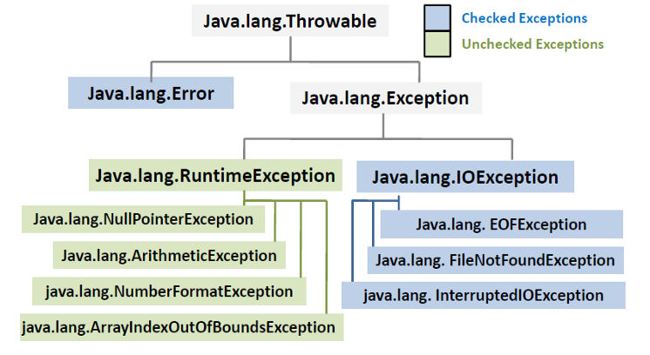

Slide 8
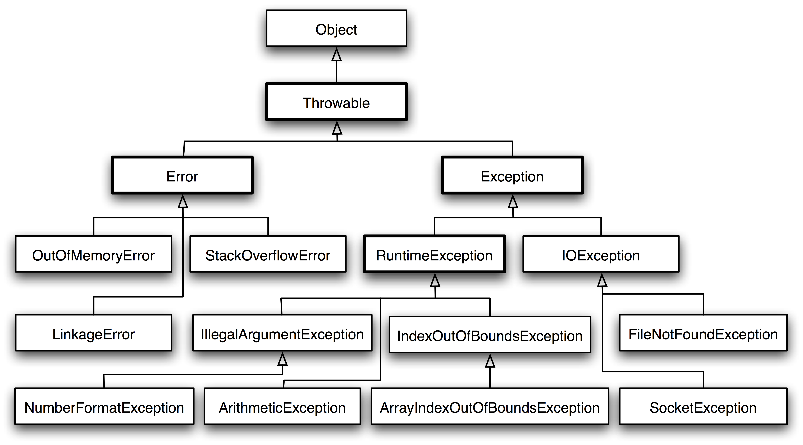

Slide 9
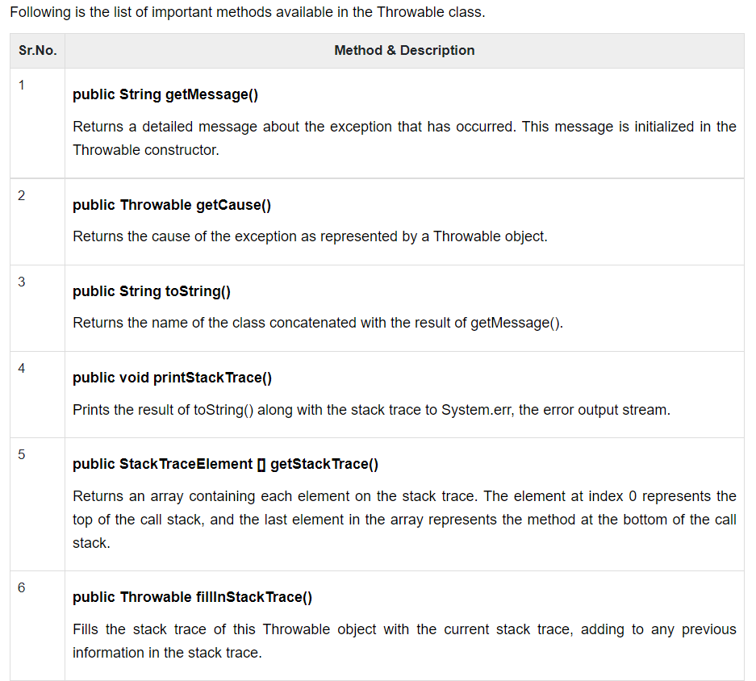

Slide 10
User-defined Exceptions
You can create your own exceptions in Java. Keep the following points in mind when writing your own exception classes
-> All exceptions must be a child of Throwable.
-> If you want to write a checked exception that is automatically enforced by the Handle or Declare Rule, you need to extend the Exception class.
-> If you want to write a runtime exception, you need to extend the RuntimeException class.
# see code examples “InsufficientFundsException.java”, “CheckingAccount.java” and “BankDemo.java”.

